Slide 1
SC2001
Project 1
SCS5 Team 1
Kiersten, Nicholas, Mythili

Slide 2
TABLE OF CONTENTS
01
03
02
04
Algorithm
implementation
Analyze time complexity
Generate
input data
Compare with original Mergesort

Slide 3
01
Algorithm implementation
Notes:
While analysing the time it takes to sort each list in an array of lists of equal size, the first list always took longer than the rest. I figured there would be some overhead due to various reasons like

Slide 4
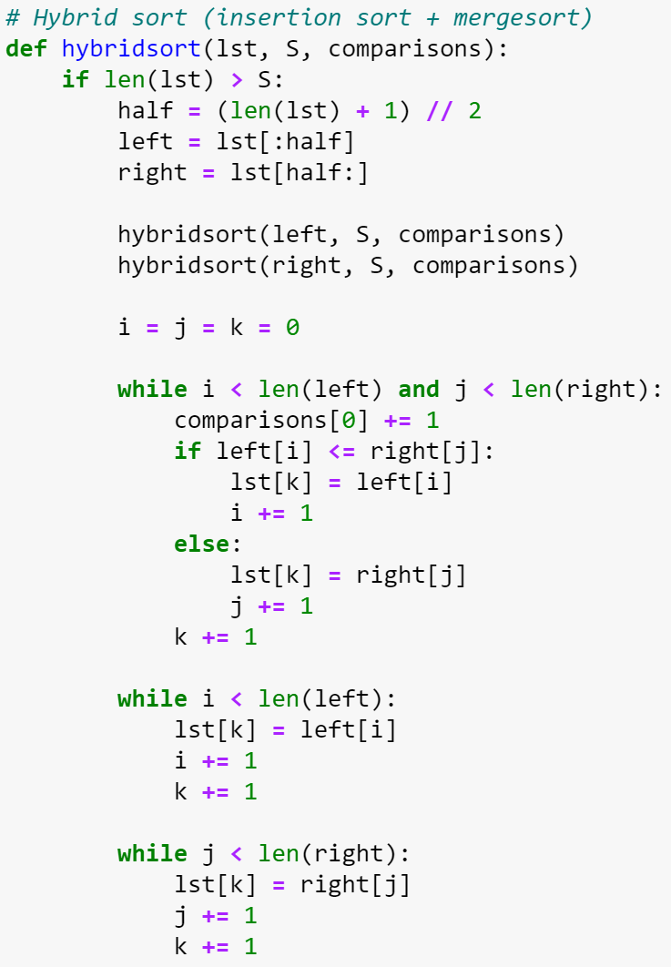

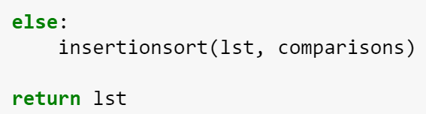
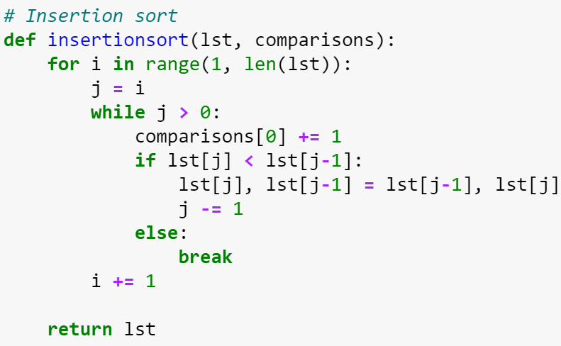

Slide 5
02
Generate input data + Main method
Notes:
While analysing the time it takes to sort each list in an array of lists of equal size, the first list always took longer than the rest. I figured there would be some overhead due to various reasons like

Slide 6
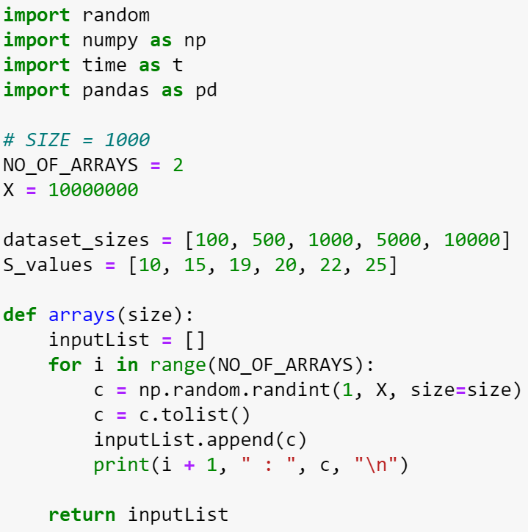

Slide 7
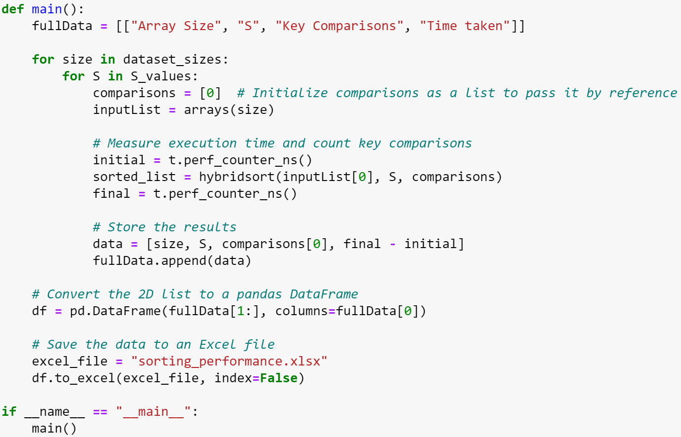

Slide 8
03
Analyze time complexity
Notes:
While analysing the time it takes to sort each list in an array of lists of equal size, the first list always took longer than the rest. I figured there would be some overhead due to various reasons like

Slide 9
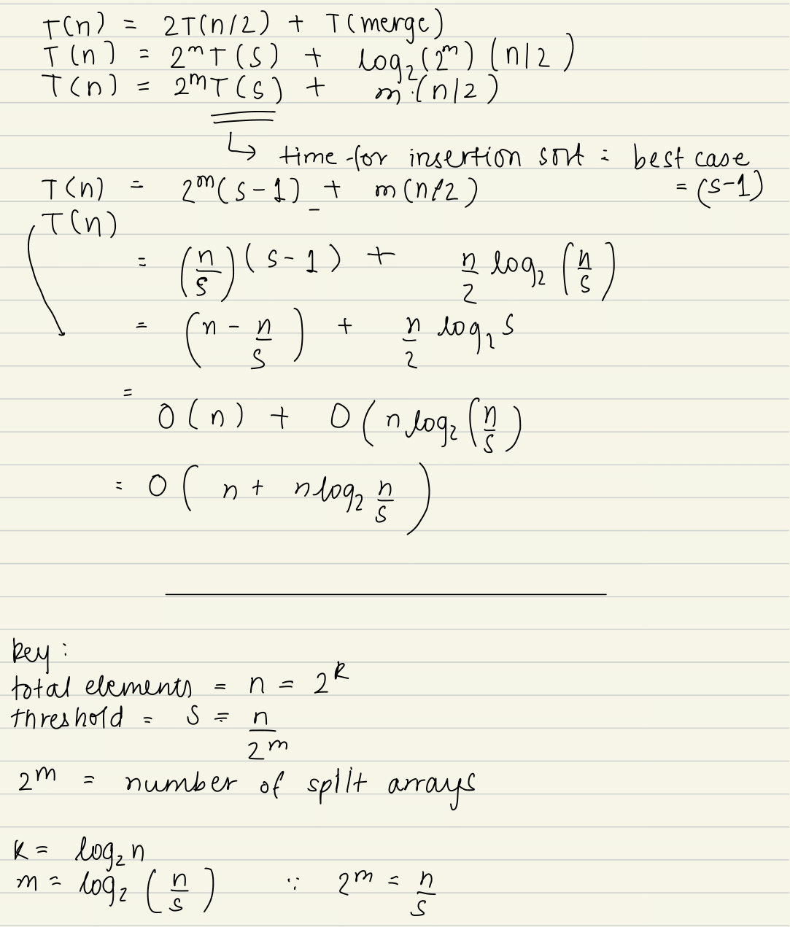
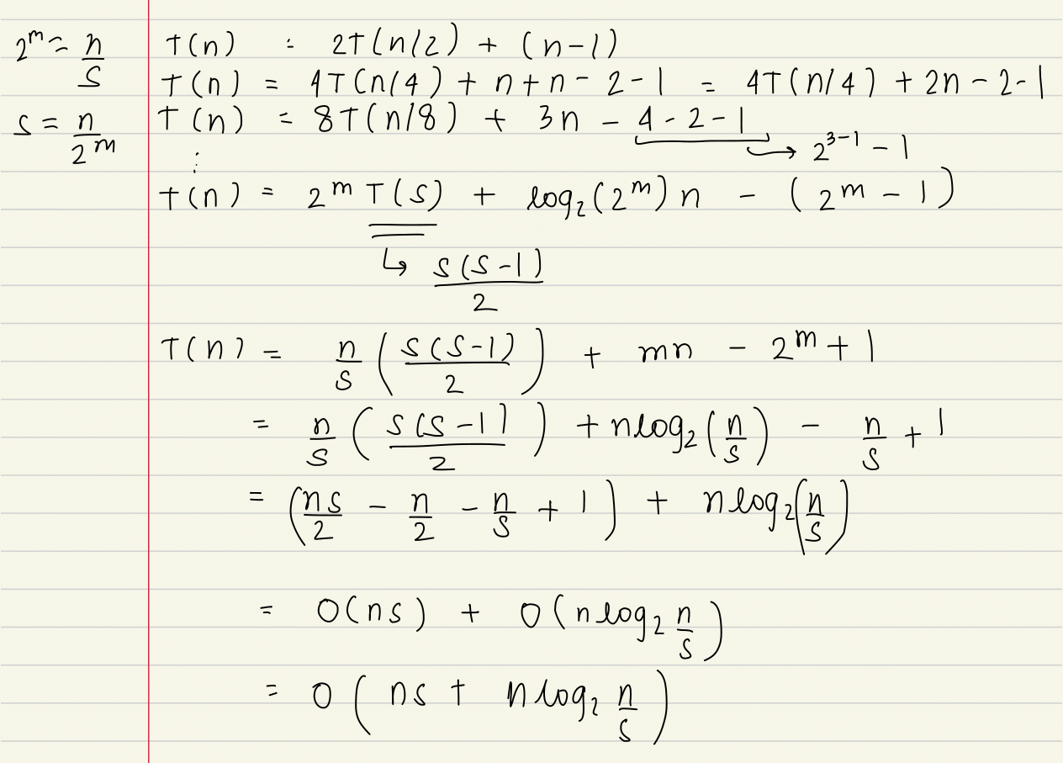
Theoretical Analysis
Best case
Worst Case

Slide 10
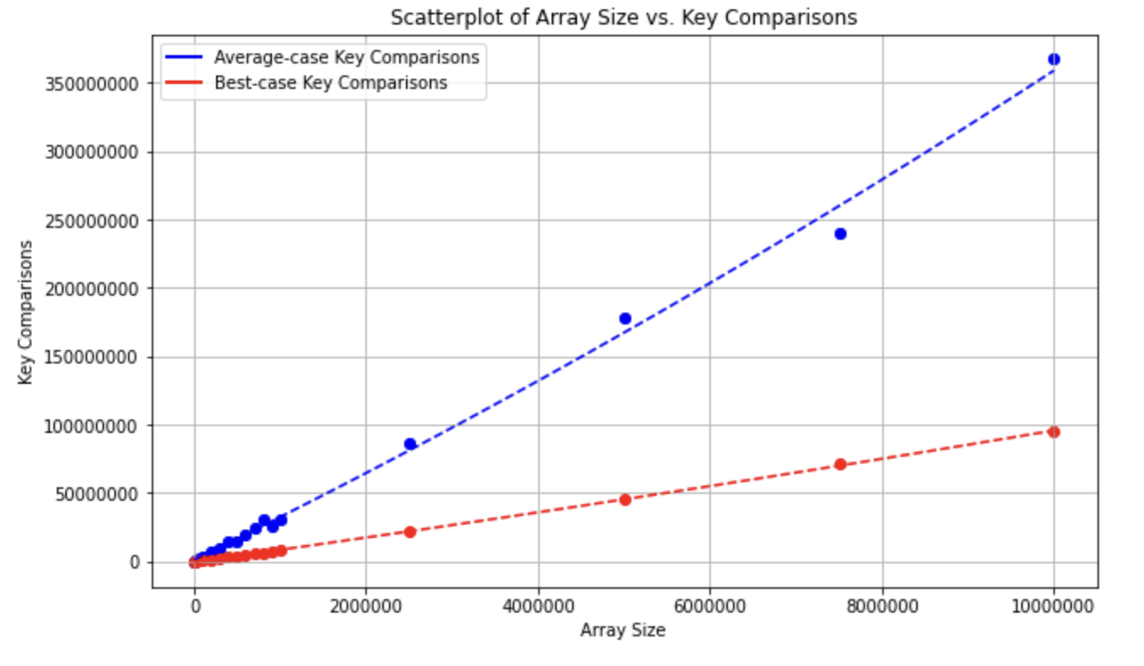
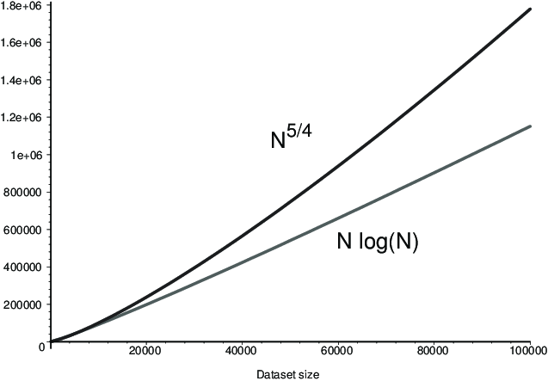
i. How key comparisons varies with input size n and fixed S = 100

Slide 11
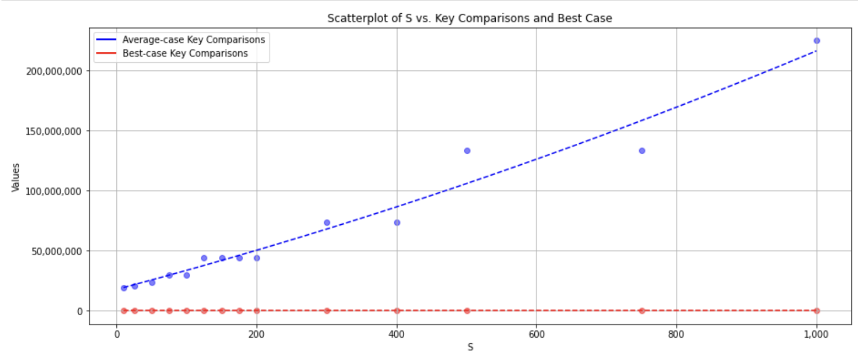
ii. How key comparisons varies with S varying and fixed input size N = 1M
Notes:
S varies from 5-1000

Slide 12
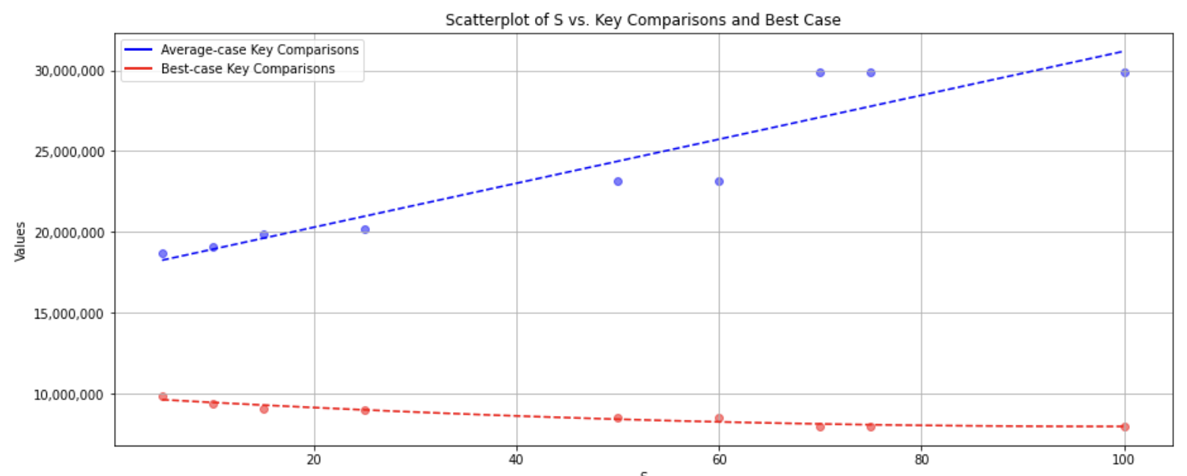
Notes:
S = 5 - 100

Slide 13
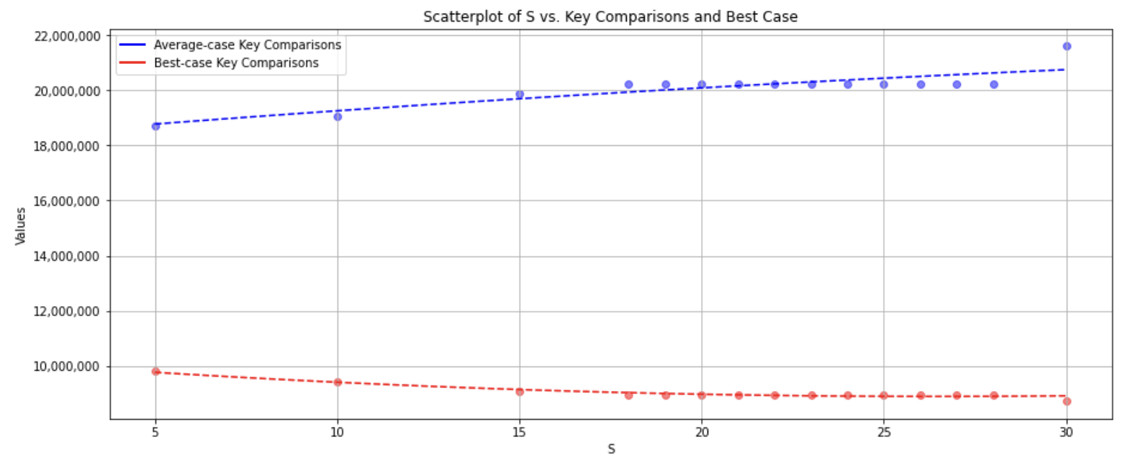
Notes:
Number of key comparisons is minimum for S = 5

Slide 14
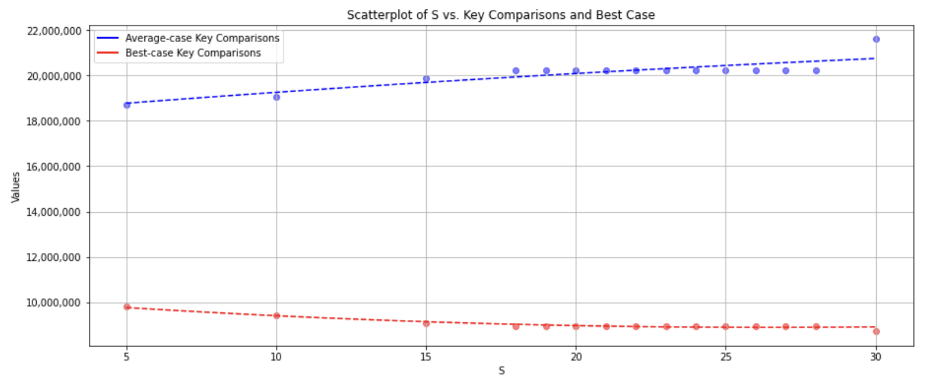
iii. Determine an optimal value of S
Key comparisons
Notes:
N = 1M

Slide 15
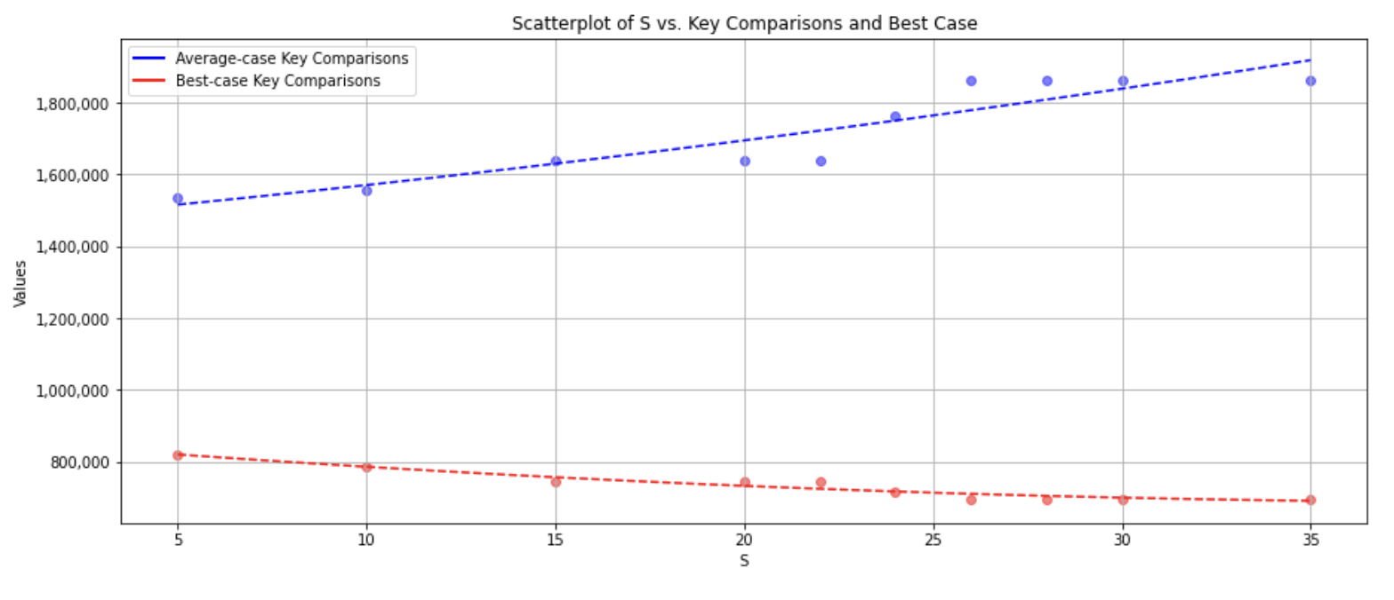
Notes:
N = 100K

Slide 16
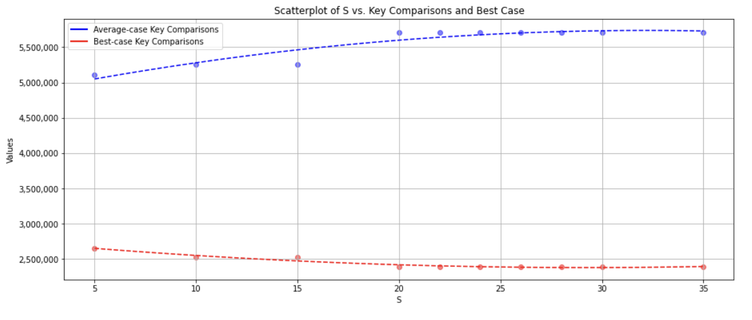
Notes:
N = 300K

Slide 17
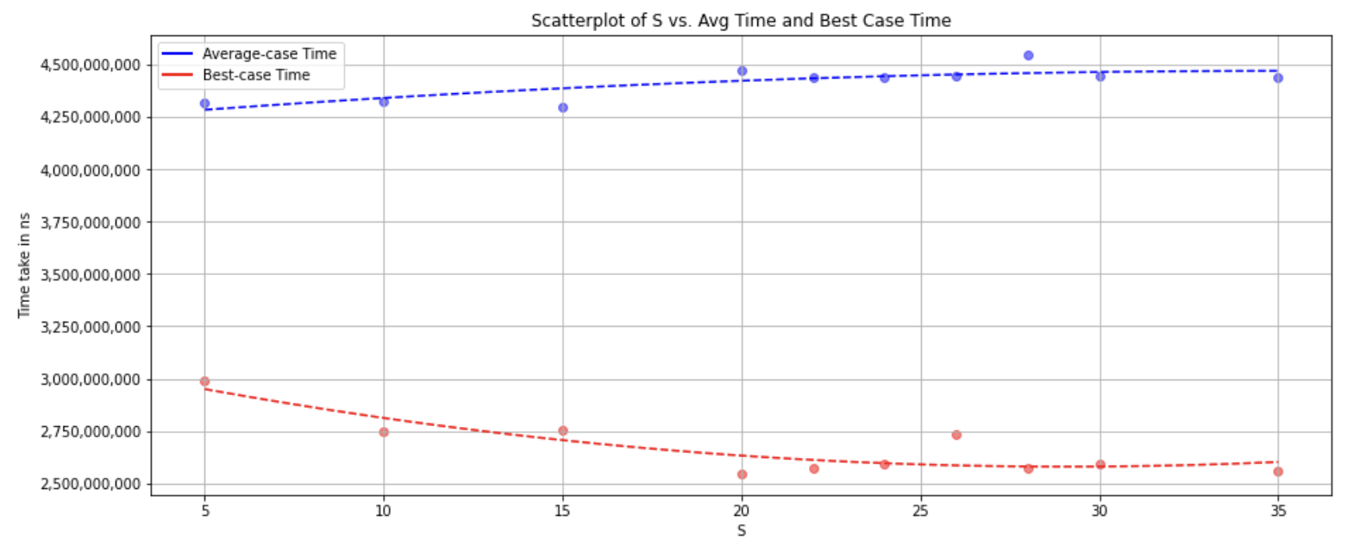
Notes:
N = 600K

Slide 18
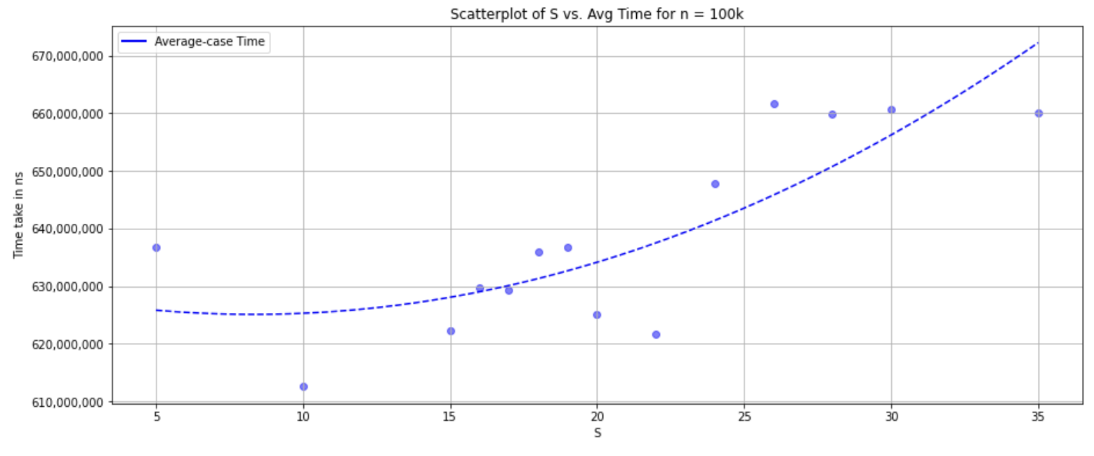
b) time taken
Notes:
Time For n = 100K

Slide 19
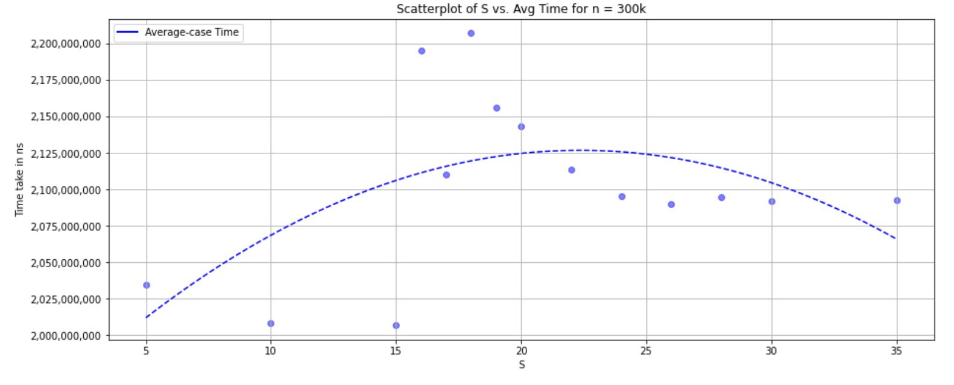
Notes:
For n = 300k

Slide 20
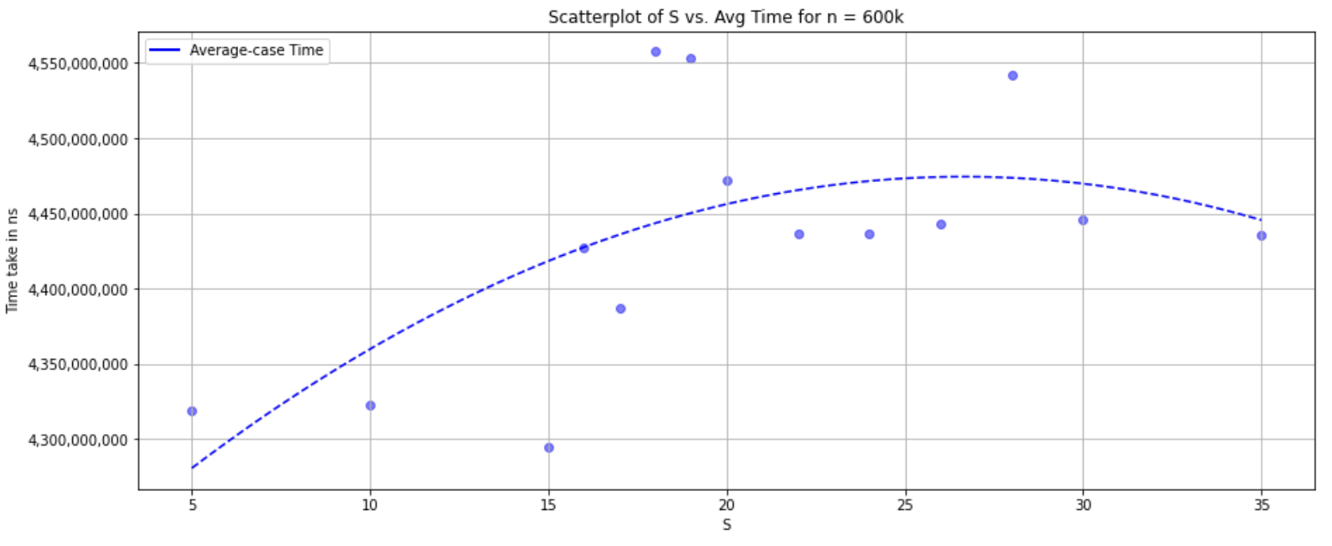

Slide 21
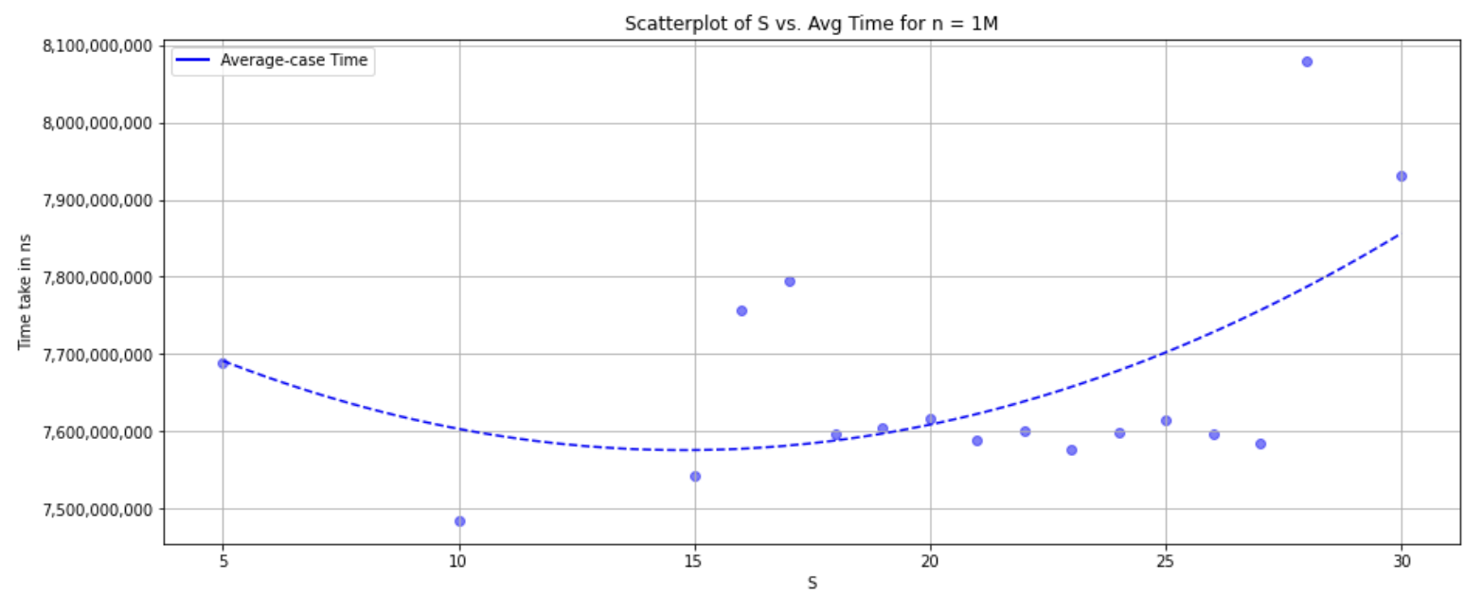

Slide 22
Conclusion
C. i) Trendline was of the form nlogn which aligned with the theoretical analysis
C. ii) Optimal value of S is 5 based only on the number of key comparisons
C. iii) Taking runtime into account; it was much greater for S= 5 as compared to S = 10~15, since for varying n the optimal value was 5, we decided that the overall optimal value should be 10

Slide 23
04
Compare with
original Mergesort
Notes:
While analysing the time it takes to sort each list in an array of lists of equal size, the first list always took longer than the rest. I figured there would be some overhead due to various reasons like

Slide 24
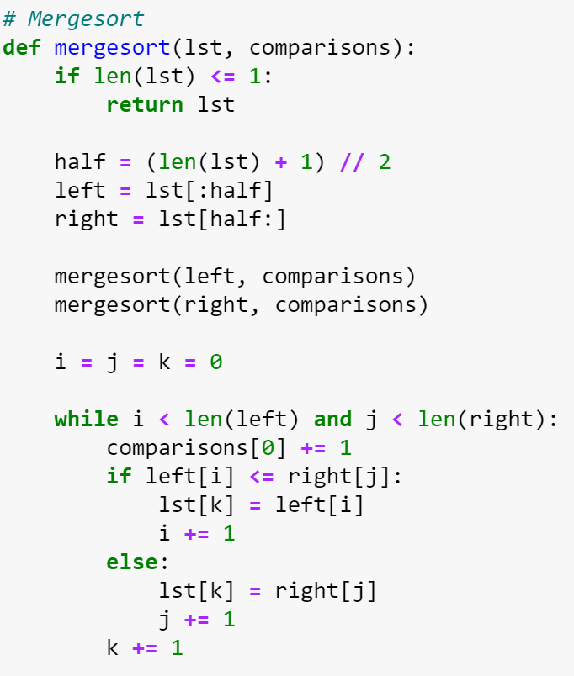
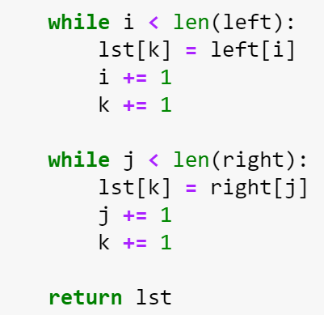
Original Mergesort

Slide 25
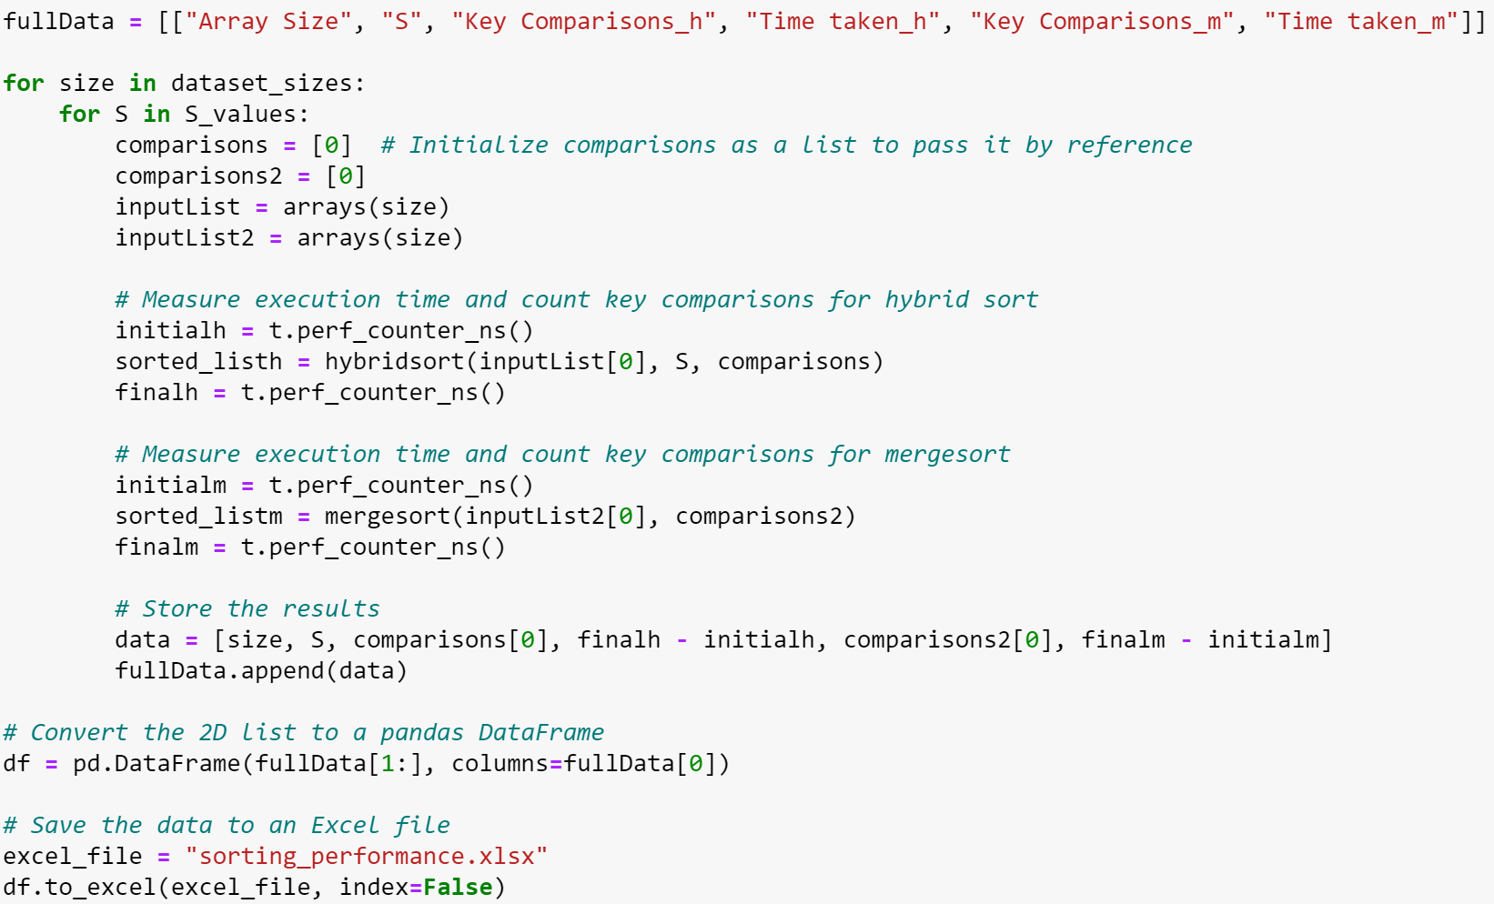
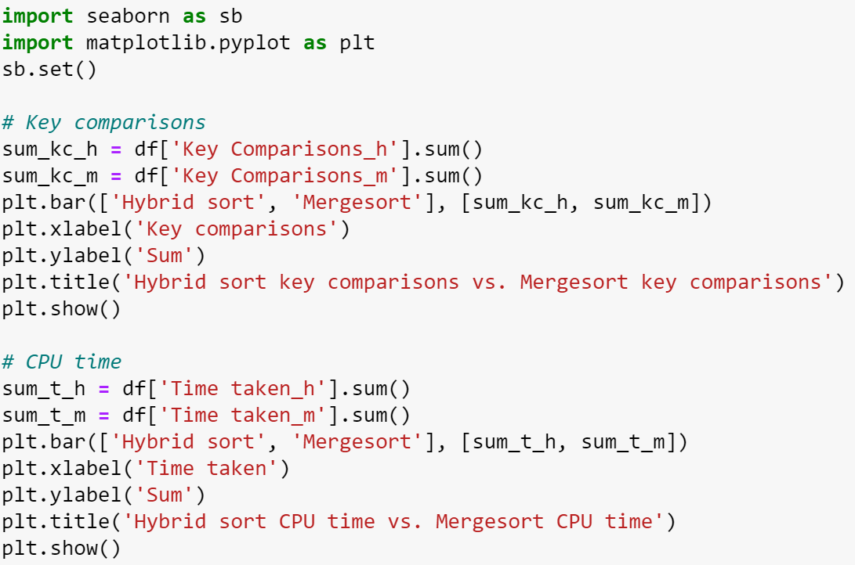
Comparing Hybrid sort
and Mergesort

Slide 26
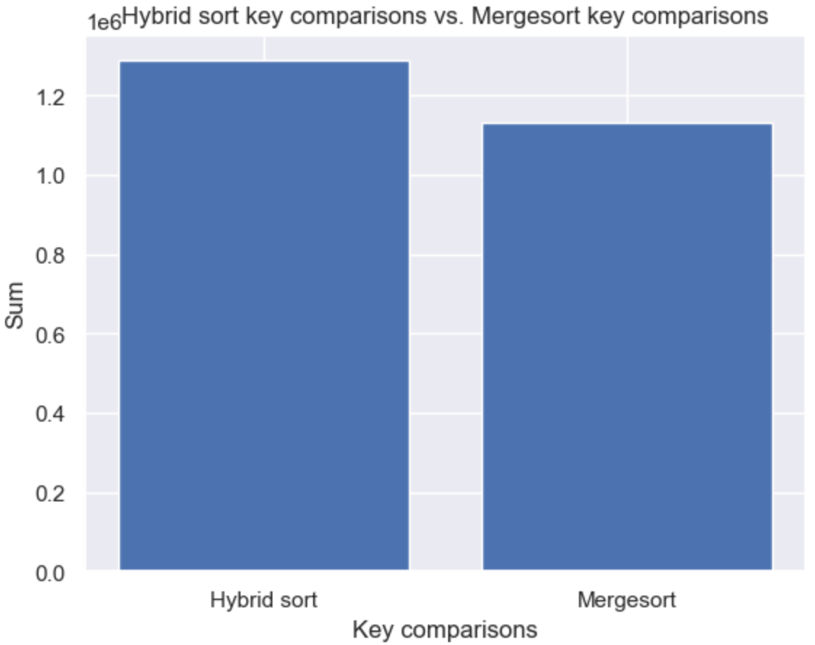
Comparison:
Number of Key Comparisons

Slide 27
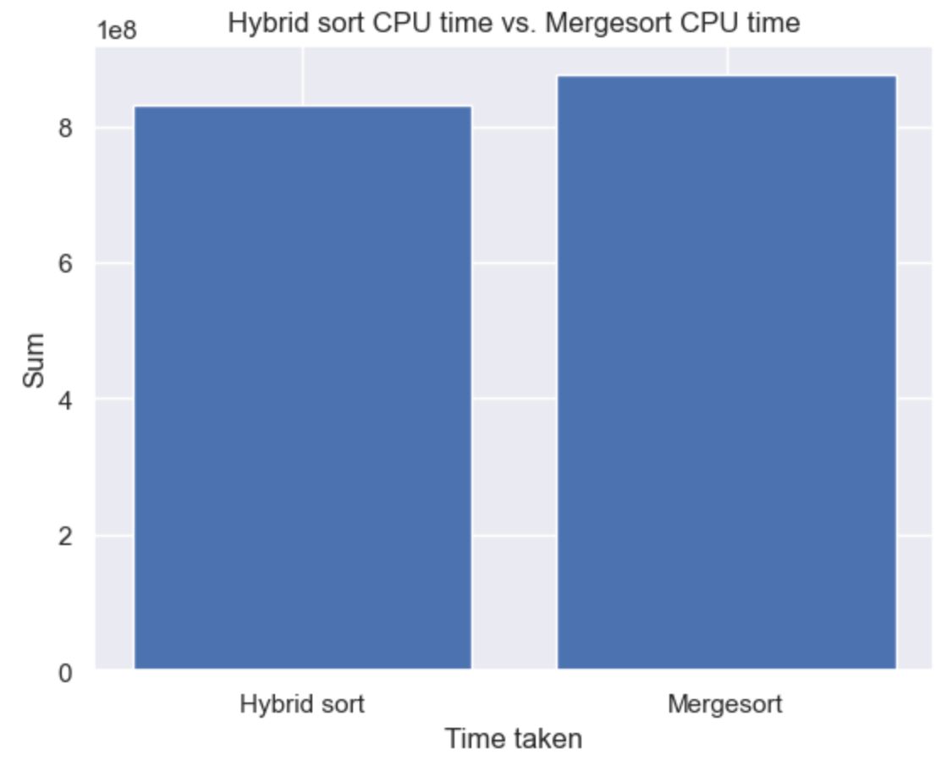
Comparison:
CPU time

Slide 28
Hybrid sort requires more key comparisons but lower CPU time as compared to the original Mergesort.
This is because CPU time takes into account the time taken for other processes as well (eg. swapping).

Slide 29
THANK YOU!
Any questions?

